Slide 1
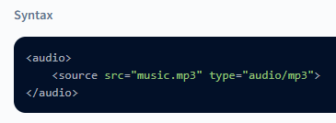
Audio Tag
HTML <audio> Tag
The <audio> tag is used to add <audio> files to your webpage. HTML5 provides this tag where you can embed music/audio files to your HTML document instead of using any third-party plugins (External Libraries). There are 3 types of files that you can add to the audio tag:
.mp3
.wav
.ogg

Slide 2

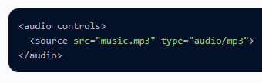
src The 'src' attribute is used to add the audio file to your HTML document. You have to provide the audio file's path here, and then only the audio will get played on the browser.
Even though this adds the audio file to your web page, you won't be able to see it. This is because you will have to add another attribute known as 'controls,' which will provide you the controls like play, pause, and audio buttons.
controls The next attribute is the controls attribute which is used to display the controls like play, pause, mute, etc., onto the browser. You must provide a control attribute inside the <audio> tag for it to get displayed.

Slide 3
Attribute | Value | Description
autoplay | autoplay | Specifies that the audio will start playing as soon as it is ready
controls | controls | Specifies that audio controls should be displayed (such as a play/pause button etc)
loop | loop | Specifies that the audio will start over again, every time it is finished
muted | muted | Specifies that the audio output should be muted
src | URL | Specifies the URL of the audio file

